Slide 1
Appendix B
DSS-28 Cost Estimation Methodology
Basis of Estimate
Cost Summary
De-scope Options

Slide 2
Cost Estimation Methodology
Developed Work Breakdown Structure (WBS)
  Cost categories: JPL Labor, P/M, P/S
Developed initial integrated schedule
Obtained cost estimates from technical leads
Time-phased labor, procurements, subcontracts consistent with integrated schedule
Calculated costs using JPL Project Cost & Analysis Tool (PCAT)
  Apply full JPL burden and business model to JPL-funded expenditures
  Bypass LCER-funded expenditures
PCAT cost walkthroughs with owners of cost elements to confirm time-phasing, establish consistency, secure commitment of doing organizations

Slide 3
Basis of Estimate
Antenna Mechanical Restoration (AMR)
  Vendor quotes from recent, identical work at DSS-27
  Strong heritage from similar work on many DSN antennas
Radiometer Subsystem (RSS)
  Vendor quotes for COTs feed horns
  Recent deliveries under subcontract of CalTech-developed LNAs
  Strong heritage, leverage of NRE from DSN Array R&D, SuperCAM
  Strong delivery history for NRAO
Antenna Control Subsystem (ACSS)
  COTs hardware, vendor quotes for encoders, control computers, interface boards
  Strong leverage of RTLinux development and support in open-source community
  Heritage and leverage of NRE from DSN APC development
  Strong delivery history for GAVRT

Slide 4
Basis of Estimate (Cont’d)
Monitor & Control Subsystem (MCSS)
  Adaptation of existing MCSS used by GAVRT, DSS-13, DSN R&D
  Strong delivery history for GAVRT
Back-End Subsystem (BESS)
  Vendor quote for prototype spectrometer
  Direct buy of mature, DSN-standard switch
  Strong heritage, leverage of NRE from JPL Radio Science Receivers
  Leverage of NRE from current RSR-based software development
Frequency & Timing System (FTS)
  Vendor quotes for recent, identical acquisitions throughout DSN
  Vendor quote for fiber

Slide 5
Cost Summary
PCAT3_14_DSS-28.pdf follows here!
Final integrated cost ($K):
  FY06 FY07 FY08 Total
  $1161.10 $1744.77 $782.34 $3688.21

Slide 6
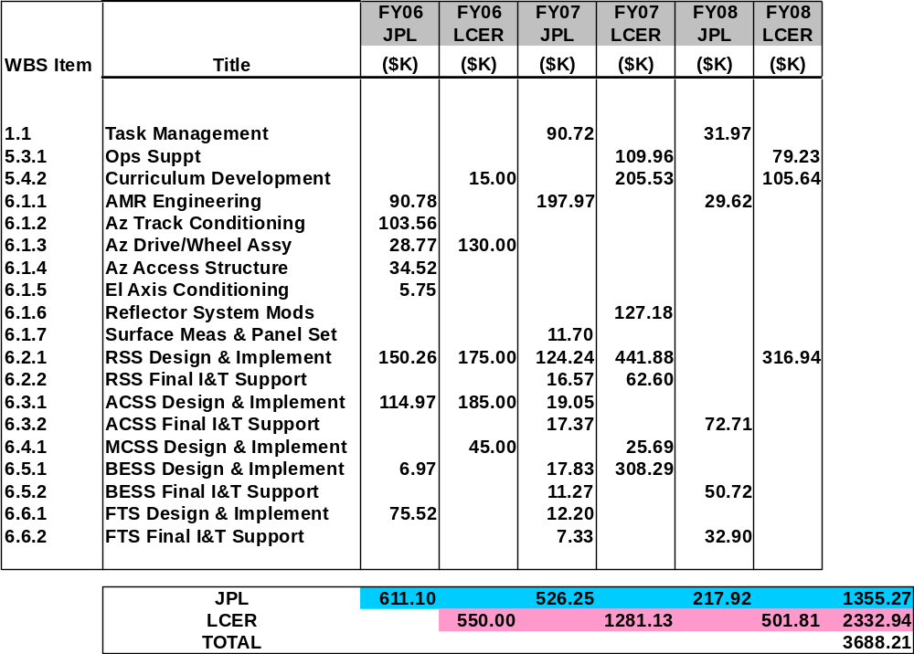
Time-Phased Color of Money

Slide 7
De-scope Options
AMR
  Defer Azimuth Track Conditioning: $104K
Project Management
  Eliminate Project I&T Engineer $123K
BESS
  Eliminate WVSR or Spectrometer $90K
  Eliminate WVSR and Spectrometer $90K
  $3688K minus $407K = $3281K
After de-scopes, the job approximately fits within the $3.2M committed funding
  With costed schedule reserve for workforce during final I&T ($271.5K)
  But otherwise with no reserve

